Slide 1
Compression Moulding
Composite Manufacturing Process
High-volume production of thermoset and thermoplastic
composite parts using matched-die moulds and heat/pressure
Process | Materials | Mould Design | Applications | Quality

Slide 2
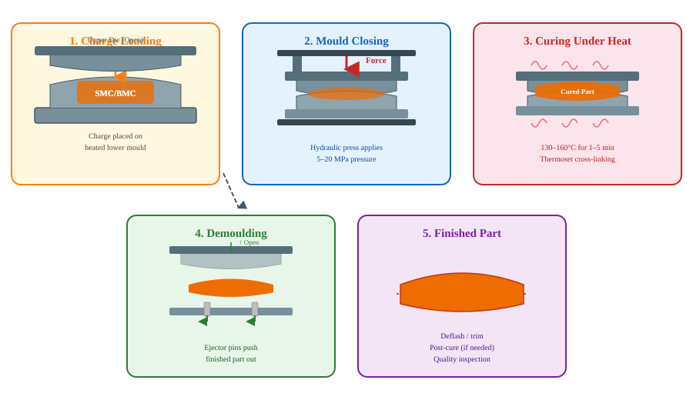
Compression Moulding Process

Slide 3
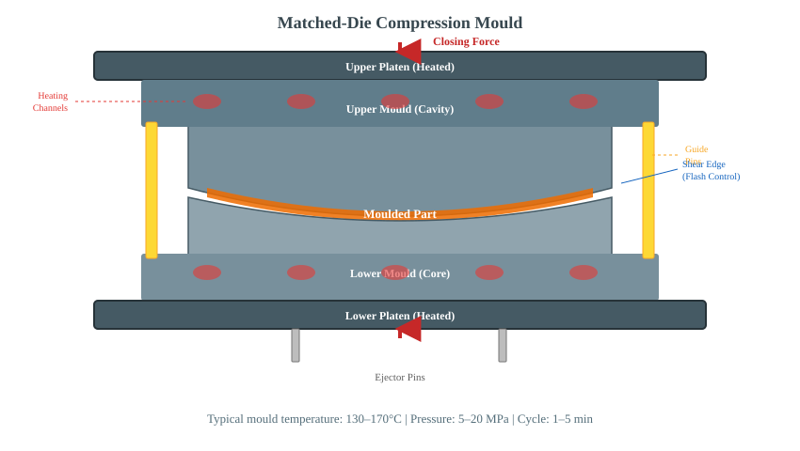
Mould Design & Construction

Slide 4
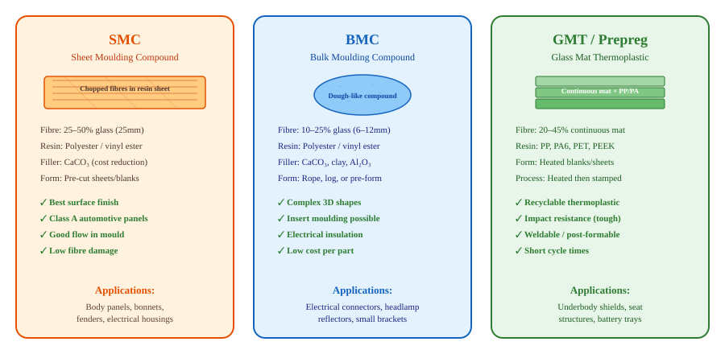
Moulding Compounds & Materials

Slide 5

Key Process Parameters
Critical Variables
Typical Cycle Breakdown
Mould Temperature
130–170°C (thermoset) — controls cure rate and surface quality
Clamping Pressure
5–20 MPa — ensures complete cavity fill and fibre compaction
Closing Speed
Slow initial close prevents fibre wash; fast final consolidation
Charge Weight & Pattern
60–80% cavity coverage; pattern controls flow and knit lines
Cure Time
1–5 min (SMC) — dictated by wall thickness and resin reactivity
Breathing / Degassing
Total cycle: 2–6 min (SMC) | Up to 30 min (thick prepreg)
Brief mould open/close cycles to vent trapped volatiles

Slide 6
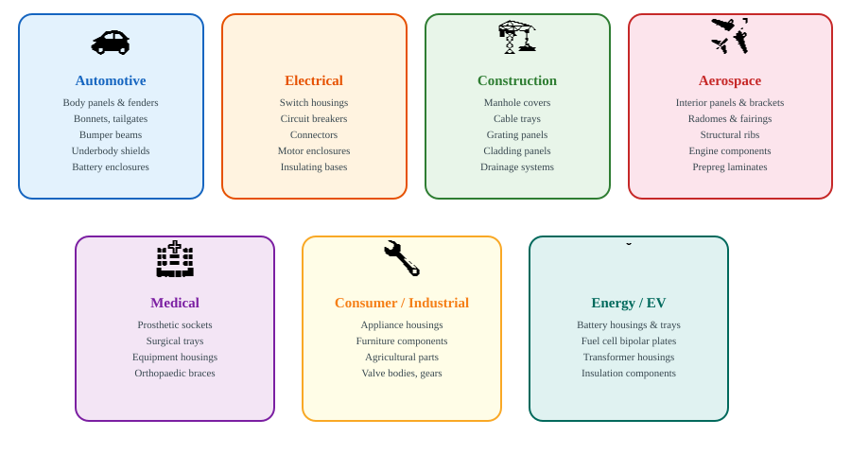
Applications

Slide 7
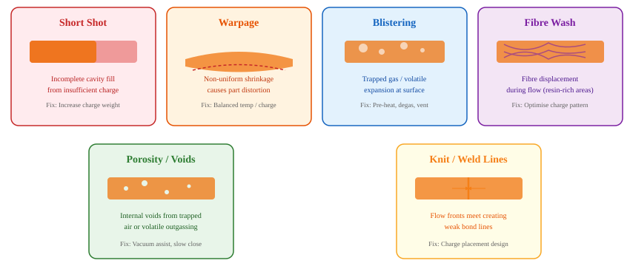
Common Defects & Remedies

Slide 8


Advantages & Limitations
Advantages
Limitations
High production volume (100k+ parts/year per tool)
High tooling cost (hardened steel matched dies)
Short cycle times (1–5 min for SMC/BMC)
Limited to relatively simple geometries (no deep undercuts)
Excellent surface finish (Class A achievable)
Flash removal / trimming adds secondary operations
Complex 3D geometry with ribs, bosses, inserts
Fibre orientation difficult to control precisely
Low material waste (90–95% utilisation)
Material shelf life limitations (SMC/BMC)
Consistent part-to-part quality
Part size limited by press tonnage capacity
Suitable for large structural panels
Thermoset parts not recyclable (cross-linked)

Slide 9
Compression Moulding vs. Other Processes
Feature | Compression Moulding | Injection Moulding | RTM / VARTM | Hand Layup
Cycle Time | 1–5 min | 0.5–2 min | 15–60 min | Hours
Fibre Length | Short–Continuous | Short only | Continuous | Continuous
Part Size | Small–Very Large | Small–Medium | Medium–Large | Any
Surface Finish | Class A | Excellent | Good | Variable
Tooling Cost | High | Very High | Medium | Low
Volume Suitability | 10k–500k+ | 100k+ | 100–10k | 1–100
Automation | High | Very High | Medium | Low

Slide 10


Summary & Future Outlook
Key Takeaways
Emerging Trends
Compression moulding is the workhorse process for high-volume composite part production
Carbon fibre SMC for lightweight structural automotive parts
SMC/BMC deliver Class A surface finish at automotive production rates
Thermoplastic compression moulding for recyclable composites
Matched-die tooling enables complex geometry with ribs, bosses, and inserts
Hybrid overmoulding — combining compression + injection in one tool
EV battery housings and structural composites are driving renewed growth
Industry 4.0 process monitoring with in-mould sensors and AI control
Thank You | Questions & Discussion

