Slide 1

The Future of
Aerospace Materials
Next-Generation Materials for Ultra-Light Aircraft
Advanced composites, nano-reinforcements, and novel architectures
shaping the next era of aerospace structural design
Carbon Fibre | Hybrid Composites | Lattice Structures | Thermoplastics | Nano-Reinforcements | High-Temp Polymers

Slide 2
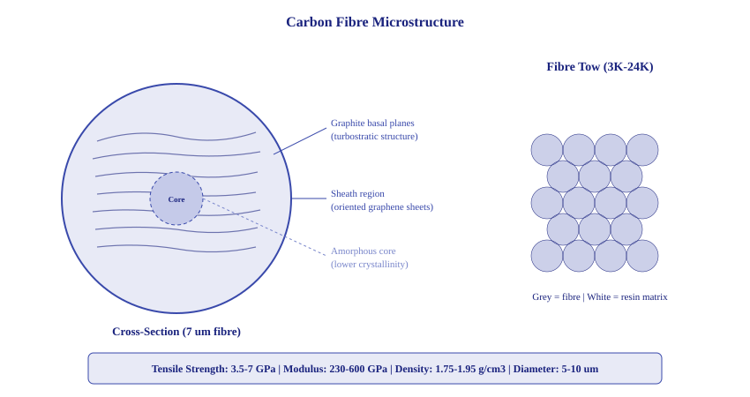
Carbon Fibre Microstructure

Slide 3
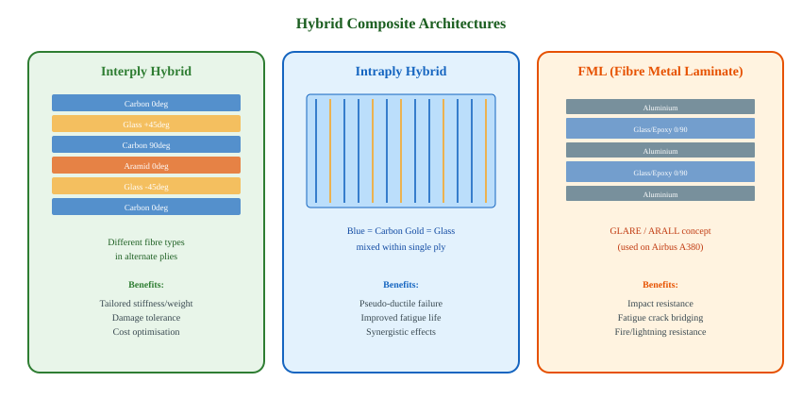
Hybrid Composites

Slide 4
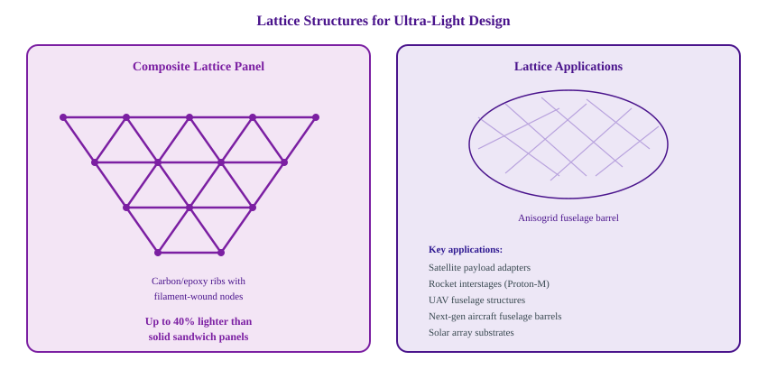
Lattice Structures

Slide 5

Thermoplastic Composites for Aerospace
Why Thermoplastics?
Key Thermoplastic Matrix Systems
Weldability
Matrix | Tg (C) | Tm (C) | Use Case
PEEK | 143 | 343 | Primary structure
PEKK | 160 | 305-360 | Fuselage clips
PPS | 90 | 280 | Leading edges
PEI | 217 | Amorph. | Interior panels
PA6/PA12 | 50-80 | 220-260 | Secondary struct.
Resistance/induction welding eliminates fasteners — 20% weight saving on joints
Recyclability
Re-meltable matrix enables closed-loop recycling and end-of-life recovery
Toughness
10x higher fracture toughness than epoxy — superior impact/damage tolerance
Rapid Processing
No autoclave cure; stamp forming in minutes instead of hours
Shelf Life
Industry Adoption
No cold storage required — unlimited out-time for prepreg materials
Airbus A350 — CF/PEEK brackets and clips
Gulfstream G650 — thermoplastic rudder
Boeing 787 — PEI interior panels
Clean Sky 2 — TP welded fuselage demonstrators
Repairability
Local re-heating allows in-situ repair of damaged structures

Slide 6
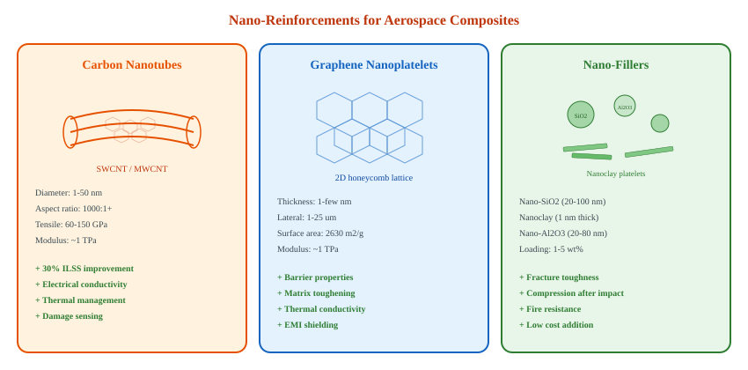
Nano-Reinforcements

Slide 7

High-Temperature Polymers
150-250 C Service
250-350 C Service
350 C+ Frontier
BMI (Bismaleimide)
Polyimide (PMR-15, HFPE-II)
Ceramic Matrix (CMC) / Hybrid
Tg ~ 250-320 C after post-cure
Tg: 340-400 C (exceptional)
SiC/SiC CMCs: 1300 C capable
Processable like epoxies (prepreg)
Long-term oxidative stability
Oxide/Oxide CMCs: 1200 C
Used on F-22 Raptor structures
GE F414 engine duct liners
LEAP engine shrouds (CFM)
Hot/wet Tg: 200 C+
Addition-type cure chemistry
GE9X combustor liners
Good microcrack resistance
Challenging processing (high Tg)
60% lighter than Ni superalloys
Fighter aircraft skins, engine nacelles, brake ducts
Engine bypass ducts, exhaust structures, missile components
Turbine shrouds, combustor liners, thermal protection

Slide 8
Material Performance Comparison
4x
Higher specific strength of CFRP vs aluminium
10x
Temperature range extension with CMCs over epoxies
30%
Further improvement with nano-enhanced matrices

Slide 9
Technology Readiness Roadmap
Current
Near-Term
2025-2030
Mid-Term
2030-2035
Long-Term
2035+
UD CFRP/Epoxy
(Boeing 787, A350)
Thermoplastic welded
structures (fuselage)
Hybrid CFRP/metal
lattice airframes
CNT-reinforced primary
structure certification
Standard prepreg
autoclave processing
Nano-enhanced toughened
epoxy systems
In-situ AFP/ATL with
real-time quality
CMC hot-section
integrated with airframe

Slide 10


Summary and Outlook
Key Takeaways
The Ultra-Light Future
Carbon fibre composites already deliver 4x specific strength vs metals — nano-enhancements push this further
Multi-functional materials — structures that sense, heal, and adapt
Thermoplastic matrices enable welding, recycling, and rapid out-of-autoclave manufacturing
Digital material twins — AI-driven design from micro to macro scale
Hybrid composites and FMLs combine best properties of different material classes
Bio-inspired architectures — mimicking natural lightweight structures
Lattice/anisogrid structures offer up to 40% weight saving over conventional sandwich panels
Sustainable composites — recyclable thermoplastics and bio-based resins
High-temperature polymers and CMCs are extending composite use into engine hot sections
Certification by analysis — reducing the test pyramid with simulation
Thank You | Questions and Discussion

